Slide 1

CIM DATABASE Architecture and Hardware Sizing Guide
Nitesh,
18.02.2022

Slide 2
Content
1
CONTACT Elements Data Flow
4
All-in-one Deployment
2
Product Support Matrix
5
Separate Server
3
Documentation access
6
Parameter for Sizing and System Landscape

Slide 3





Contact Elements Data Flow
CENTRAL SITE
Application Server
Web Server
Replication Server
REMOTE SITE
Network Edge Service
Replication Server
Clients
Replicated Data
File Transfer
Electronic Vault
stored in electronic vaults
high bandwidth
low impact of latency
Meta Data
Clients connect directly to central
SQL Database (Oracle, Microsoft SQL Server)
stored in the SQL database
small bandwidth
high impact of latency

Slide 4
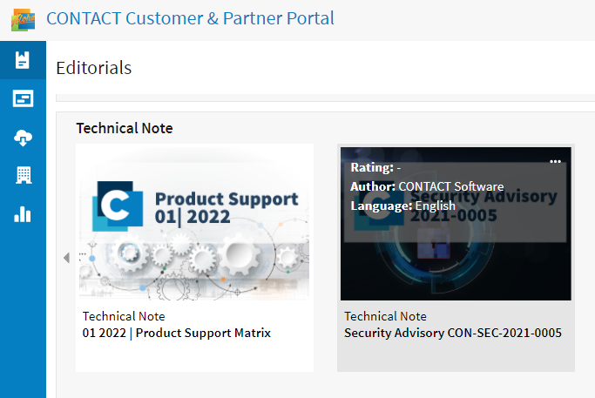
Product Support Matrix
Software Download Portal https://aloha.contact-software.com
Search for “support” within “Editorials” or directly navigate to: Editorials →… Technical Note → Product Support Matrix or navigate to Software → CONTACT Elements Platform 15.5 (LTS) → … Product Support
Elements Platform 15.5 (LTS or latest version) will be used

Slide 5
CONTACT Software Product Support For CONTACT Elements 15.5
Client OS, Web browser
Microsoft Edge (Chromium), Chrome, Firefox
Windows 10 (64 bit)
Server OS (Application Server)
Windows Server 2016 (64 bit)
Windows Server 2019 (64 bit)
Suse Linux Enterprise Server 12.4 (64 bit)
Suse Linux Enterprise Server 12.5 (64 bit)
Suse Linux Enterprise Server 15 (64 bit)
Linux others (Please contact us to check the availability if needed)
DBMS
Oracle 12c R1 (12.1) (Using Oracle 12c needs a license migration to Oracle Database Standard Edition 2)
Oracle 19c (12.2, LTSR) (Using Oracle 12c needs a license migration to Oracle Database Standard Edition 2)
MS SQL Server 2012 (Only on Windows platforms; Minimum requirement for MS SQL Server (201x) is the standard edition)
MS SQL Server 2014 (Only on Windows platforms ; Minimum requirement for MS SQL Server (201x) is the standard edition)
MS SQL Server 2016 (Only on Windows platforms ; Minimum requirement for MS SQL Server (201x) is the standard edition)
MS SQL Server 2017 (Only on Windows platforms ; Minimum requirement for MS SQL Server (201x) is the standard edition)
MS SQL Server 2019 (Only on Windows platforms ; Minimum requirement for MS SQL Server (201x) is the standard edition)

Slide 6
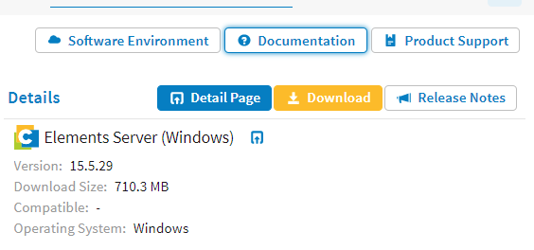
Documentation access
Navigate within Aloha to Software → CONTACT Elements 15.5 (LTS) → Documentation
Navigate within the documentation portal to Administration Manuals → CONTACT Elements: Installation and Maintenance

Slide 7



All-in-one Deployment (useful for development)
at least 100 MBit
at least 1 GBit
Application Server
Blobstore
Web Server
DCS (Format Conversion)
Viewing Conversion 3D
Windows Client
SQL Database

Slide 8



Separate Servers
DCS Server
(Format Conversion)
Blobstore
at least 100 MBit
SQL Database
Windows Client
at least 1 GBit
3D Server
(Format Conversion
for Viewing Formats)
Application Server
Web Server

Slide 9

Parameter for Sizing #1
Input Parameters for RAM-Sizing
Number of concurrent users (nu)
Number of licensed users
Licensed users with document management profile (ndu)
Licensed users with cad management profile (ncu)
Estimate of nu: nu = ndu / 3 + ncu / 1.5 (recommendation STA: nu*2)
Example:
100 users with document management profile → ndu
0 users with cad management profile → ncu nu = 100 / 3 = 34 concurrent users (recommendation STA: nu*2 → nu=68)
Number of concurrent users is input parameter for RAM sizing
Estimate number
of concurrent users

Slide 10

Parameter for Sizing #2 RAM
Application Server Sizing
Minimum 2 CPU core
one CPU core per ~30 concurrent users
Total core = max (8, nu/30) ➔ max (8, 68/30) ➔ 8 core
4 GB RAM for server base load
300 MB RAM per concurrent user (nu)
Total RAM = max (32GB, 4GB + nu * 0.3GB)
Example 68 concurrent users:
➔ max (32 GB, 4GB + 68 * 0.3 GB) ➔ 32 GB
Database Server
Minimum 8 CPU core
one CPU core per ~30 concurrent users
Total core = max (8, nu/30) ➔ max (8, 68/30) ➔ 8 core
1 GB RAM for DB + 100 MB RAM per concurrent user (nu)
Total RAM = max (16GB, 1GB + nu * 0.1GB) (recommendation STA: nu*2)
Example 68 concurrent users:
➔ max (16GB, 1GB + 68 * 0.1GB) ➔ 16GB
App-Server and Database Server

Slide 11

Parameter for Sizing #3
Connect AppServer and DB as fast as you can, at least 1 Gbps, latency < 1 ms
Between all servers at least 1 Gbps, 10 Gbps for larger deployments
Connect clients with at least 100 Mbps, 1 Gbps for CAD users
As clients communicate exclusively with the application server there is no need to expose servers apart from the application server in the network
Remote Sites
if latency < 50 ms, clients may connect remotely without support of edge server
if latency > 100 ms use edge server on remote site to which clients connect
Bandwidth: at least 1 Mbps for usage of CDB without replication
Bandwidth: depending on intended usage, with cad usage use vault replication on remote site and bandwidth calculated for intended replication volume
Example: Remote site creates 1000 MB of changed files daily which should be replicated during off hours within 2 hours -> bandwidth = 1000 MB x 8 / 2 x 3600 s ~ 1-2 Mbps additionally
Take into account traffic in both directions for syncing
Network

Slide 12

Parameter for Sizing #4
DCS (Automated Format Conversions)
Minimum 4 CPU Cores
8GB RAM
The configuration of a DCS – it’s RAM in particular – should correspond to the configuration of a typical CAD workstation. If conversion corresponds to MS-Office files only then MS-Office prerequisites should be fulfilled.
Load on the DCS depends on the conversion chain being used. The conversion of 3D CAD documents is about as expensive as opening the CAD model on a workstation.
If the DCS has sufficient RAM (no swapping occurs), the turnover rate is mainly affected by the cpu. If you find that the server’s capacity is often exhausted, multiple DCS instances may be used in parallel.
Document Conversion Server (DCS and 3D)
3D

Slide 13

Parameter for Sizing #5
Enterprise Search Server
Takes at least 4 CPU cores
RAM requirement ~ 16 GB
Recommended configuration is additional server apart from Appserver
Enterprise Search Server

Slide 14

Parameter for Sizing #6
Application Server
Base Software ~ 2GB
Configuration ~ 10 GB
Additional Thirdparty Software ~ 50 GB
SCCS, Office-Software (MS Office), Viewer-Software
Storage Components
Fileserver
Blobstorage, total storage for all documents, typical initial size ~ 100 GB
Enterprise Search Server
Base Software ~ 2 GB
Text Extraction, storage approx. equal to size of all indexable documents
(total size of all office documents)
Text Index, approx. equal to Text Extraction size
Database
Base Software ~ 10 GB (ORACLE or SQL Server)
Tablespaces ~ 50 GB
Backup ~ 50 GB

Slide 15


IT Infrastructure Approach PROD - Step 1 & 2 [Proposal]
min.100 MBit
min.1 GBit
SQL Database
Application + Web Server Enterprise Search BlobStore (Vault)
Blobstore on separate drive (partition)
Desktop / Notebook
MS Internet Explorer 11
DCS Server
3D Rendering
Enterprise Search Server

Slide 16

IT Infrastructure Approach Step 1 & 2 [Proposal]
Enterprise Search
DB
3 SQL instances
PROD
QS
Dev
DCS
Prod
QS
Dev
File Store
Preferably independent training server to avoid disturbances
Training

Slide 17
Summary – Minimum configuration required
 | RAM | HDD | CPU | Remarks
Application Server (Production) | 32 GB | 64 GB | 8 core | More resources might be required depending on applications, including third party, running on this server
Blobstore / File Repository | - | 100 GB | - | Can be a separate file server or separate disk on application server. The actual size depends on data volume
Database Server | 16 GB | 110 GB | 8 core
Enterprise Server | 16 GB | 100 GB | 4 core | As data and usage grows, demand of resources will grow
Data Conversion Server | 8 GB | 100 GB | 4 core | As data and usage grows, demand of resources will grow

Slide 18
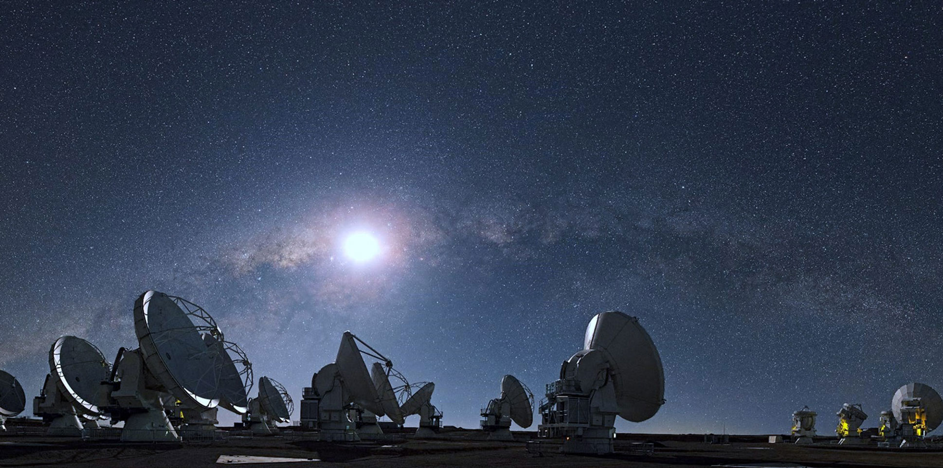
Thank You!
Nitesh.chaturvedi@contact-software.com
www.contact-software.com
energizing great minds

Slide 19
© 2021 CONTACT Software GmbH or a CONTACT Software GmbH affiliate
Fonts
Headline
36 pt. Source Sans Pro Black
Text Level 1
23 pt Source Sans Pro Light
Text Level 2
18 pt Source Sans Pro Light
Colours
Corporate
Agenda hints
Font agenda items:
23 pt SSP Semibold
Never more than 6 items. Simply delete items not needed
Avoid ultra short chapters with just one or two pages
In shorter presentations: use agenda slide just in the beginning
No part of this publication may be reproduced or transmitted in any form or for any purpose without the permission of CONTACT Software GmbH or a CONTACT Software GmbH affiliate. The information contained herein may be changed without prior notice.
Third Party Trademark Notices
Adobe, the Adobe logo, Acrobat, Flash, PostScript, and Reader are either registered trademarks or trademarks of Adobe Systems Incorporated in the United States and / or other countries.
Amazon Web Services, the “Powered by Amazon Web Services” logo and Amazon S3 are trademarks of Amazon.com, Inc. or its affiliates in the United States and/or other countries.
Apple, App Store, FaceTime, iBooks, iPad, iPhone, iPhoto, iPod, iTunes, Mac OS, Multi-Touch, Objective-C, Retina, Safari, Siri, and Xcode are trademarks or registered trademarks of Apple Inc.
Git and the Git logo are either registered trademarks or trademarks of Software Freedom Conservancy, Inc., corporate home of the Git Project, in the United States and/or other countries.
Google App Engine, Google Apps, Google Checkout, Google Chrome, Google Data API, Google Maps, Google Mobile Ads, Google Mobile Updater, Google Mobile, Google Store, Google Sync, Google Updater, Google Voice, Google Mail, Gmail, YouTube, Dalvik, and Android are trademarks or registered trademarks of Google Inc.
HTML, XML, XHTML, and W3C are trademarks, registered trademarks, or claimed as generic terms by the Massachusetts Institute of Technology (MIT), European Research Consortium for Informatics and Mathematics (ERCIM), or Keio University.
Microsoft, Windows, Windows Phone, Excel, Outlook, PowerPoint, Silverlight, and Visual Studio are registered trademarks of Microsoft Corporation in the United States and other countries.
Linux is the registered trademark of Linus Torvalds in the United States and other countries.
Mozilla and Firefox and their logos are registered trademarks of the Mozilla Foundation.
SAP, SAP ABAP, SAP HANA and SAP NetWeaver are registered trademarks of SAP in Germany and other countries
All other product and service names mentioned are the trademarks of their respective companies.
CONTACT Trademark Notices
CONTACT Software, CONTACT Elements, CONTACT CIM Database, CONTACT Project Office, CONTACT Workspaces and CONTACT Elements for IoT are registered trademarks of CONTACT Software GmbH.
CIM Database
Elements for IoT
Special Hints for separator:
Gradient Corporate:
Collaboration Hub
Project Office
Gradient Collaboration Hub:
Gradient IoT:
Gradient Project Office:

Slide 20
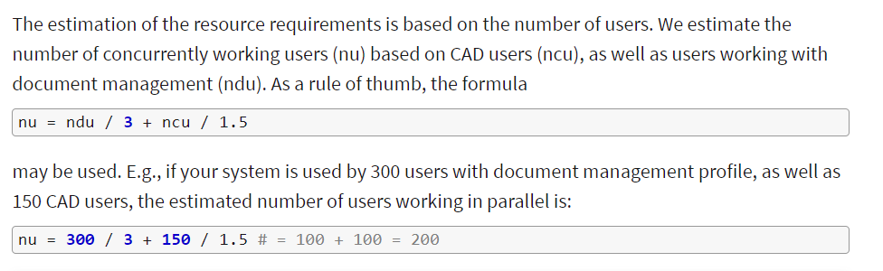
Calculation Formula : Concurrent Users
Source :- https://aloha.contact-software.com/docportal/15.5/en/admin/platform/platform-requirements

Slide 21
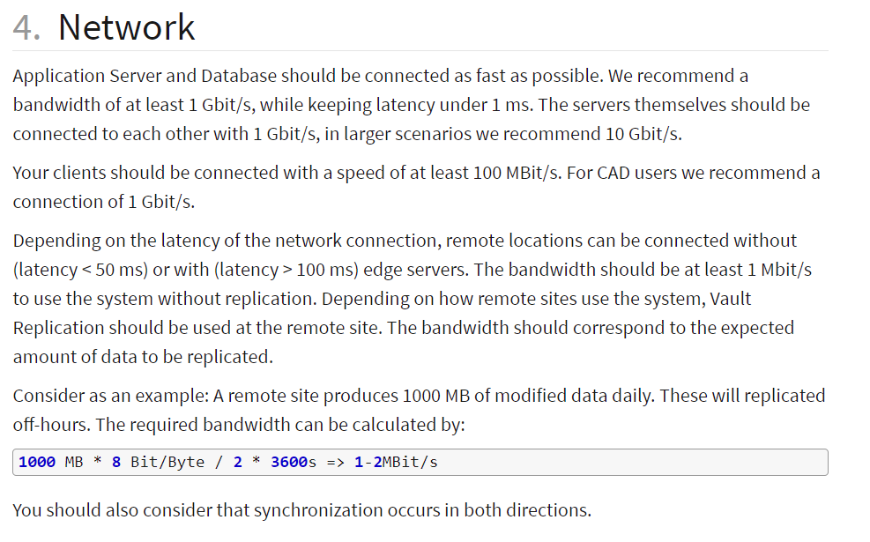
Calculation Formula : Network

